Slide 1
Lending Club Case Study
Submitted by – Shabnam Sardar Santosh Mahto

Slide 2
Objective
Business Objectives¶
This company is the largest online loan marketplace, facilitating personal loans, business loans, and financing of medical procedures. Borrowers can easily access lower interest rate loans through a fast online interface. Like most other lending companies, lending loans to ‘risky’ applicants is the largest source of financial loss (called credit loss). Credit loss is the amount of money lost by the lender when the borrower refuses to pay or runs away with the money owed. In other words, borrowers who default cause the largest amount of loss to the lenders. In this case, the customers labeled as 'charged-off' are the 'defaulters’
Goal
the company wants to understand the driving factors (or driver variables) behind loan default, i.e. the variables which are strong indicators of default. The company can utilise this knowledge for its portfolio and risk assessment.

Slide 3
Business Understanding
The data given below contains information about past loan applicants and whether they ‘defaulted’ or not. The aim is to identify patterns which indicate if a person is likely to default, which may be used for taking actions such as denying the loan, reducing the amount of loan, lending (to risky applicants) at a higher interest rate, etc.’
When a person applies for a loan, there are two types of decisions that could be taken by the company:
Loan accepted: If the company approves the loan, there are 3 possible scenarios described below:
Fully paid: Applicant has fully paid the loan (the principal and the interest rate)
Current: Applicant is in the process of paying the installments, i.e. the tenure of the loan is not yet completed. These candidates are not labeled as 'defaulted'.
Charged-off: Applicant has not paid the installments in due time for a long period of time, i.e. he/she has defaulted on the loan

Slide 4
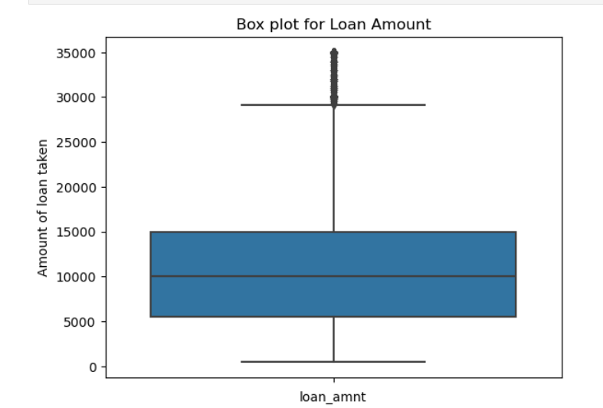
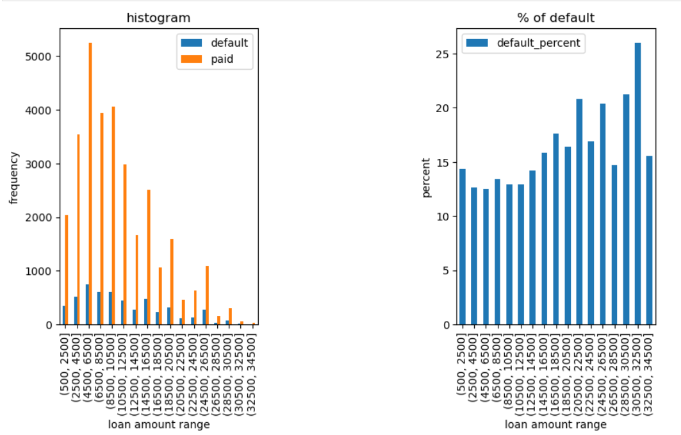
Analysis Loan Status and Amount
Loan Status: The loan amount varies from ~ 500 to 35000 with a mean of 9800.
Loan Amount - High chances of default for 30500 – 32500 range

Slide 5
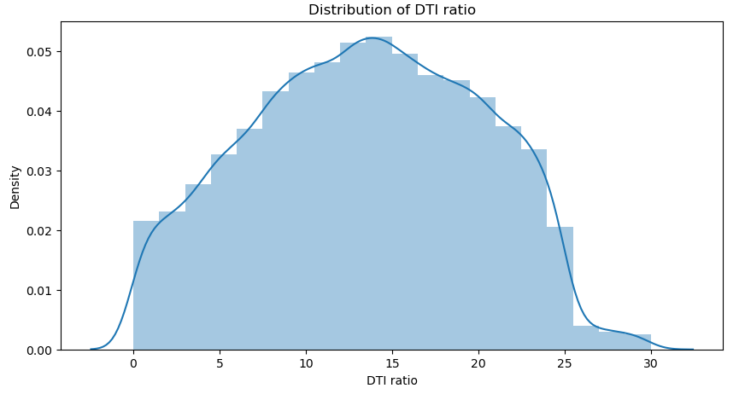
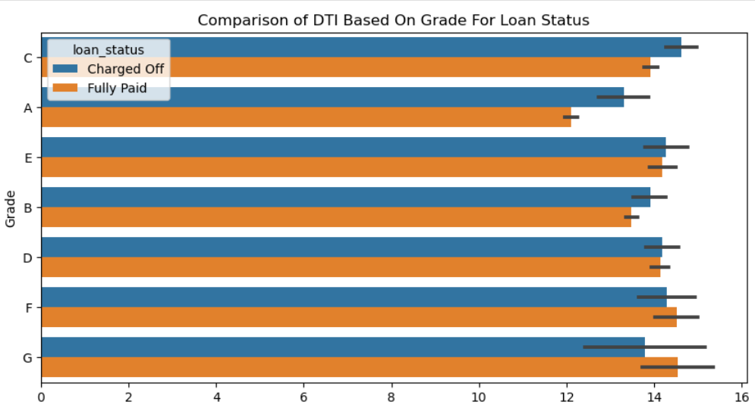
DTI and Grade
DTI: The Grade A which is lowest risk also has lowest DTI ratio hence higher grade has higher rate of default (DTI increases Default chance increases with increase in "Debt to income ratio“
Majority of the borrowers have very large debt compared to the income registered (DTI), in the 10-15 DTI ratio.

Slide 6
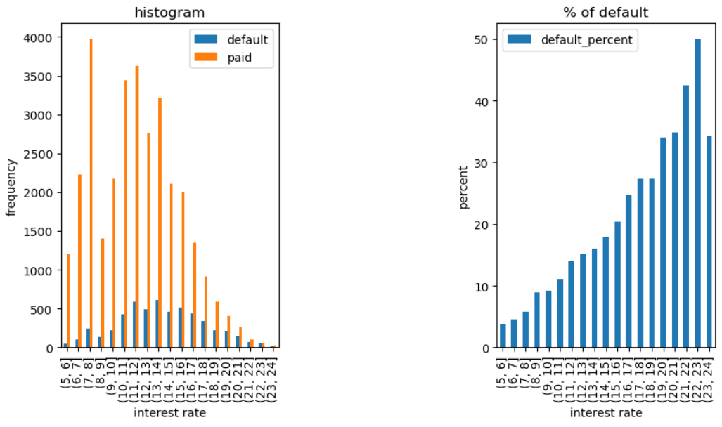
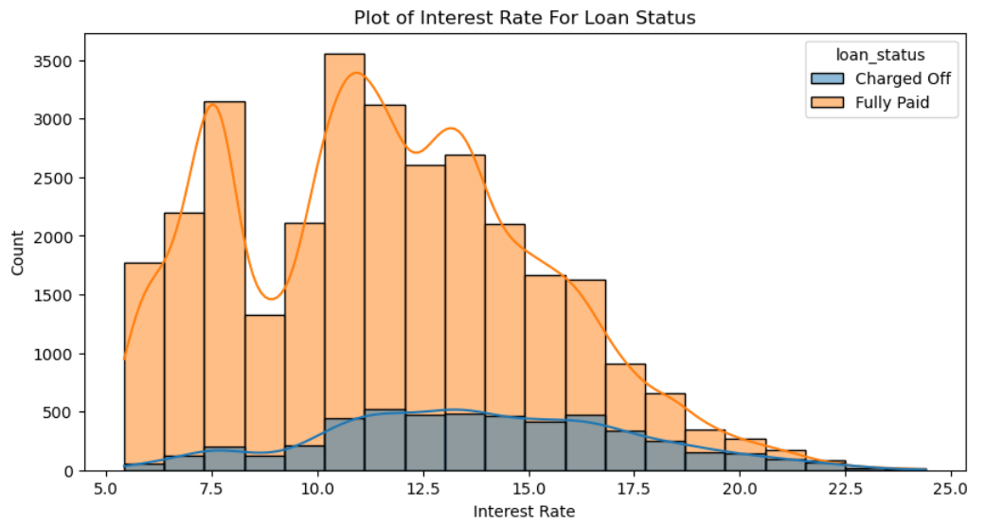
Loan status and Interest Rate
Interest rate: The default loan amount are more with interest rate 10 to 15%
Interest Rate: Chances of default increases with increase in interest rate

Slide 7
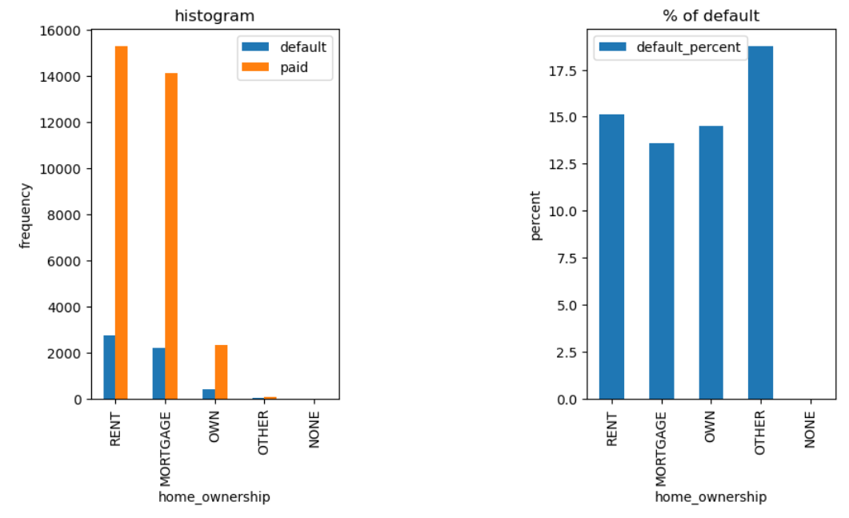
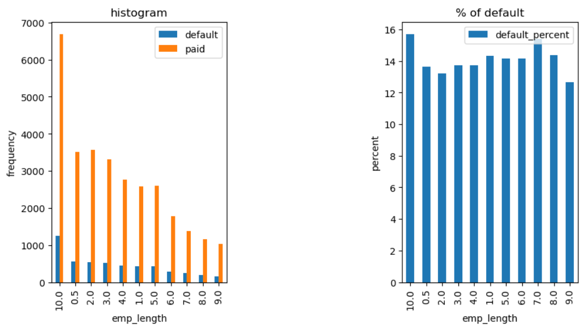
Employment Length & Homeownership
Employment Length: High chances of default 10+ years", "7 years"- Lowest chances of default "2 years" , "9 years"
Home Ownership: The Defaulted loan are more for Mortgage , Rent and Other Categories

Slide 8
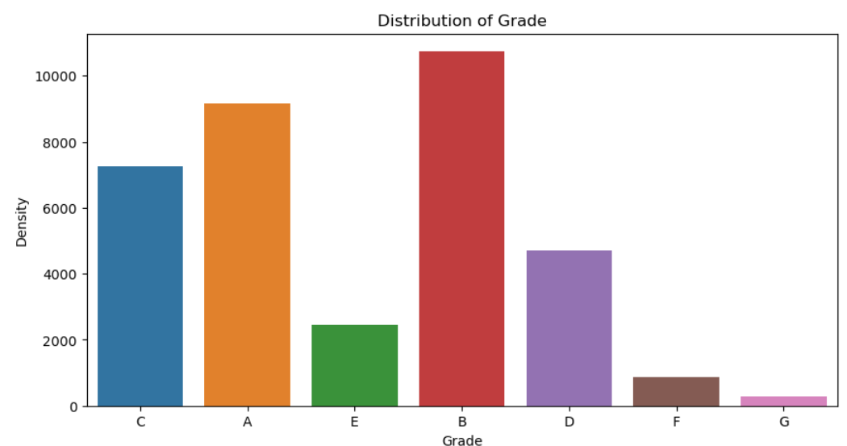
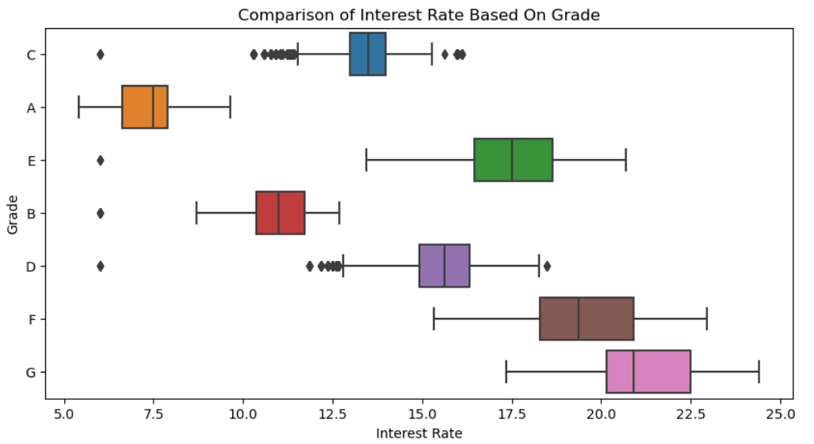
Grade vs Interest Rate
Grade: A large % of loans are in grade 'A' and 'B' compared to rest showing most loans are high grade loans.
The Grade represent risk factor hence interest rate increases with the risk.

Slide 9
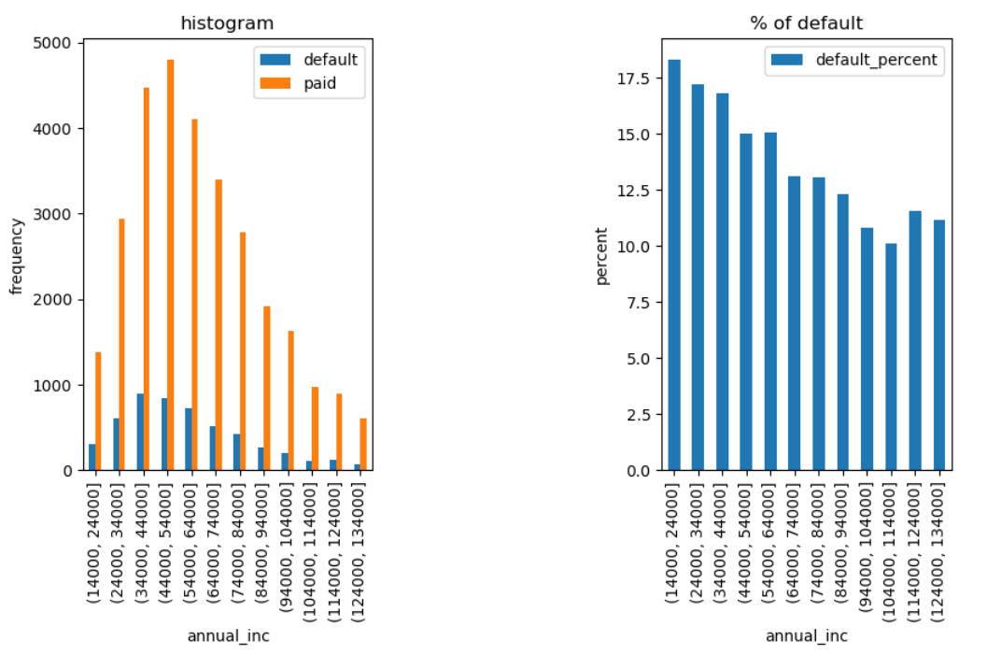
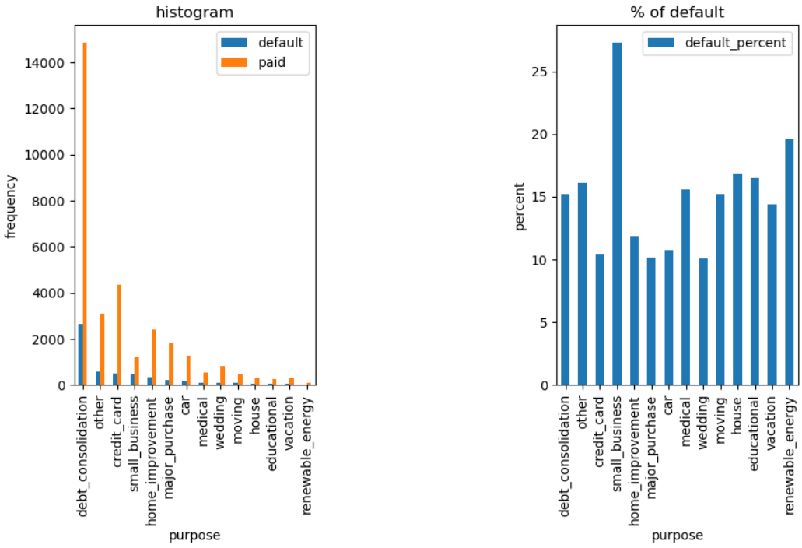
Annual Income & Purpose
Annual Income : Chances of Default decreses significantly with increase in annual income but increase slighty with highest annual income
Purpose: - High chances of default debt_consolidation, small business, renewable energy Lowest chances of default - major purchase, car, wedding**

Slide 10
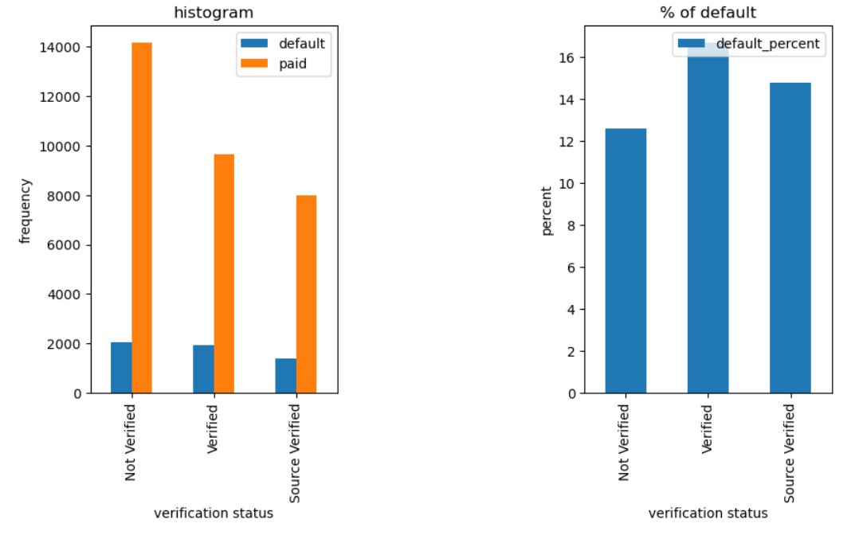
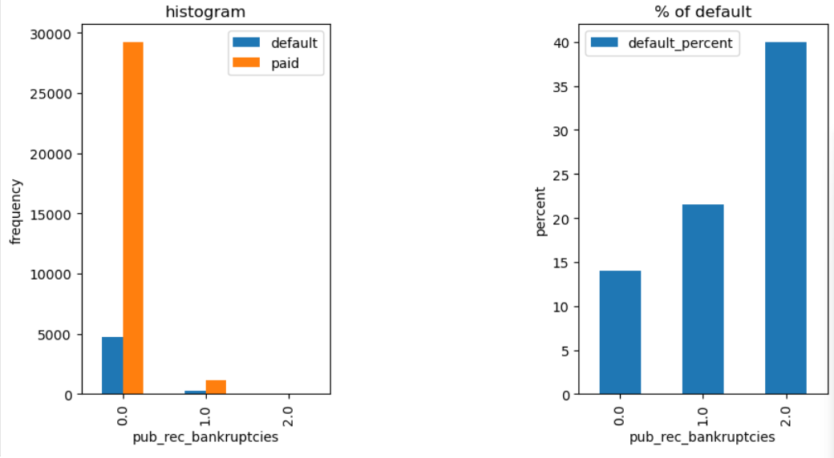
Public Bankruptcy , Verification status
Bankruptcy
Chances of default increases with pub_rec_bankruptcies
Verification status –
Default count decreases with better verification status

Slide 11
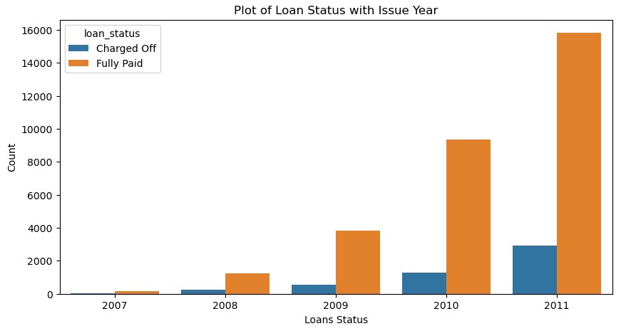
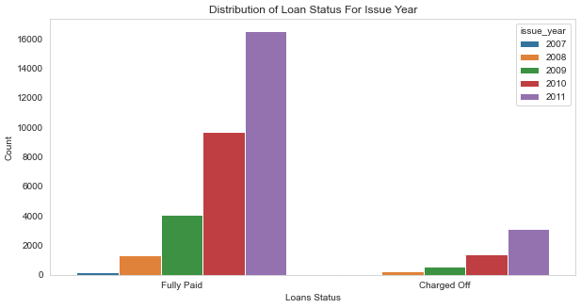
Trend of loan over years
The Fully paid loan are increasing exponentially with the time compared to defaulted loan

Slide 12
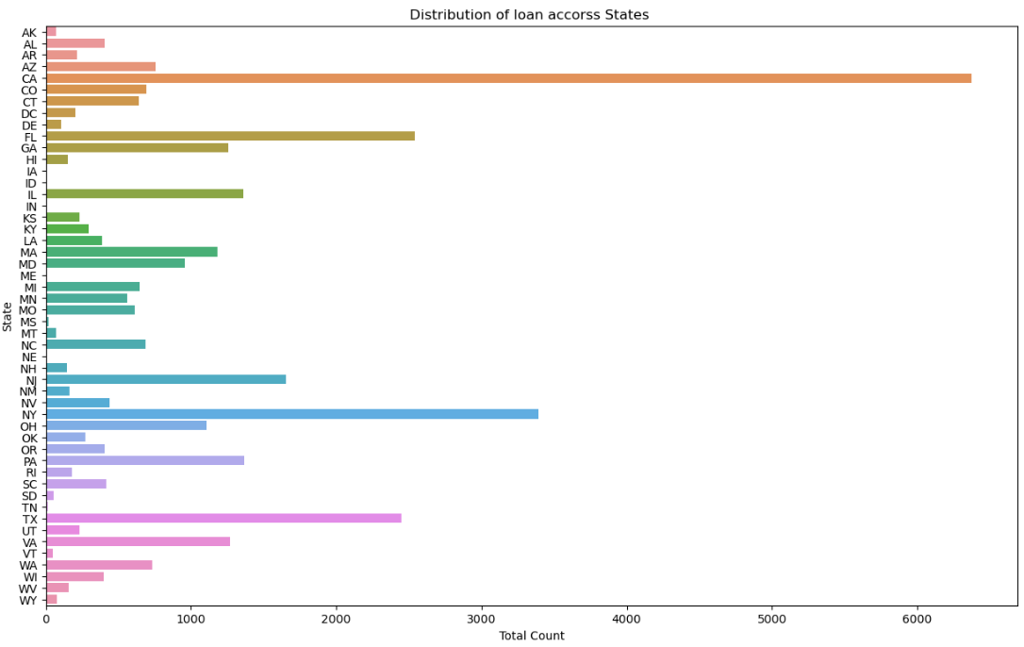
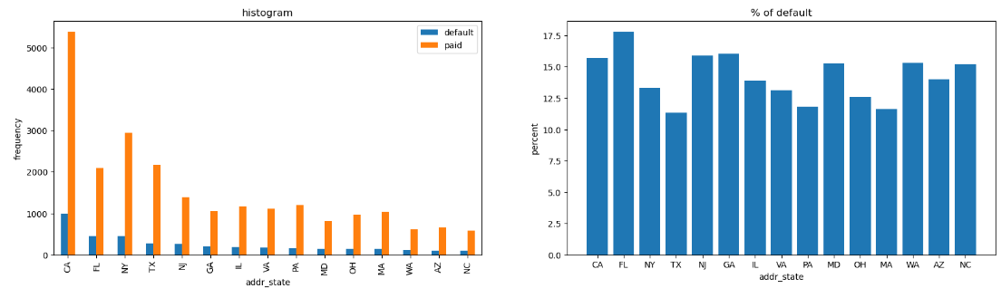
Location Based
Majority of the borrowers are from the large urban cities like california, new york, texas, florida etc. High chances of default : NV,FL and CA- Lowest chances of default :TX

Slide 13
Conclusion
Driving factor which can be used to predict the chance of defaulting and avoiding Credit Loss: -
DTI
Interest Rates
Verification Status
Annual income
Public Recorded Bankruptcy.
Address - Borrowers from large urban cities like California, new york, Texas, Florida etc have more defaulters - Borrowers less income range 50000 are more likely to default
Grades - Borrower with least grades like E,F,G which indicates high risk.
Years of experience - Burrowers with working experience 10+ years has more defaults

